Slide 1
Let’s Predict the Weather!
By Gabriel Muller and Harry Walters

Slide 2
What do we want to do?
Predict whether it will rain given some basic parameters
Apply different statistical models to predict with much less data and less computational power
We’ll explore the data, clean the data, apply 2 models to the data
Logistic regression (finding how important each parameter is to predict a binary output)
Multi-layer-perceptron (neural network) (finding the optimal weights of each parameter to predict a numerical output)

Slide 3
How?
For each day, we will condense the past 7 days of rainfall, the date and some summary data (mean and median rainfall for the week)
We will then find how important each off the 11 parameters are for predicting rainfall
Rainfall 1 day ago | Rainfall 2 days ago | Rainfall 3 days ago | Rainfall 4 days ago | Rainfall 5 days ago | Rainfall 6 days ago | Rainfall 7 days ago | Mean | Median | Today
3.2 | 4.0 | 2.5 | 1.0 | 32.0 | 1.2 | 0.0 | 6.3 | 3.2 | 8.5

Slide 4
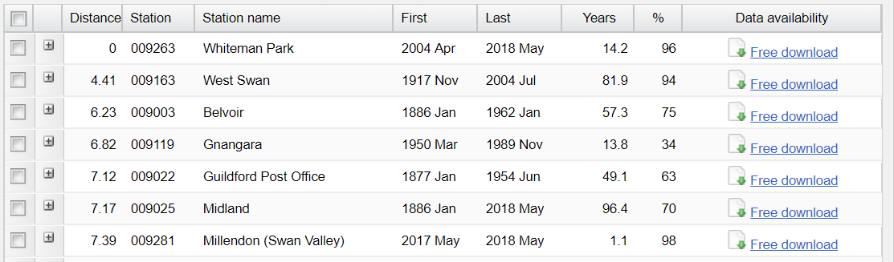
Where do we get our data from?
http://www.bom.gov.au/climate/data/stations/
We wanted a dataset recorded over many years that we could clean up
There are 5227 observations in our data
There are 300 missing rainfall values from our raw data (our data is about 94.3% complete)
The daily rainfall data was free

Slide 5
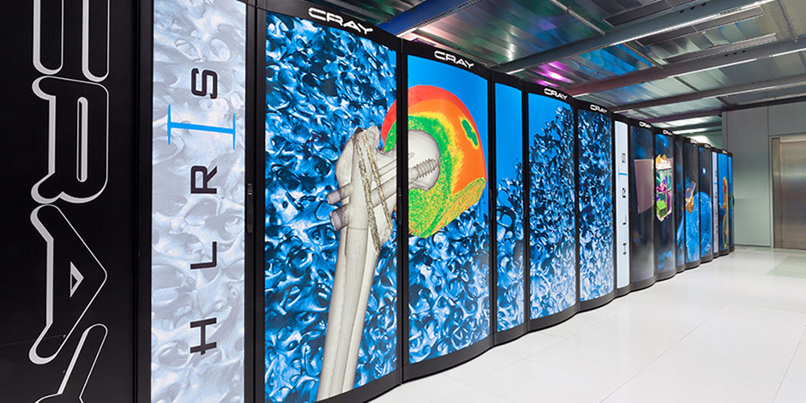
BOM Model
The Bureau of Meteorology’s weather model uses hundreds of thousands of datapoints and parameters to predict the weather forecast.
The models are computationally expensive.
It’s also financially expensive!
Source: https://www.hlrs.de/systems/cray-xc40-hornet/

Slide 6
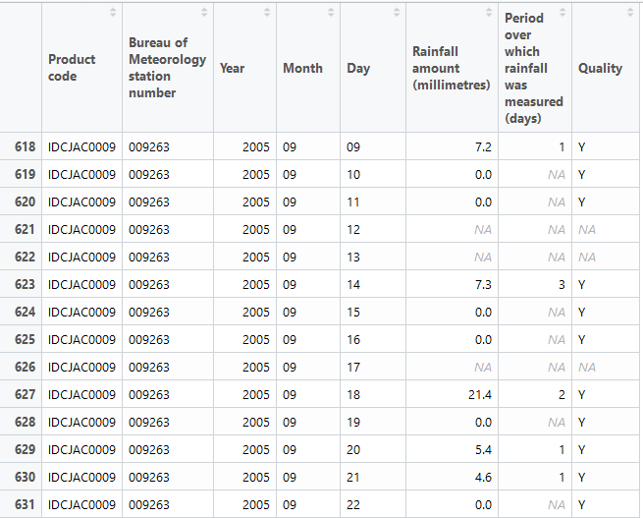
What does our raw data look like?
Y = a day of data passed a quality check.
N = a day of data hasn’t been checked.
NA = data wasn’t recorded/didn’t meet quality standards or was measured over multiple days

Slide 7
A closer look
We don’t need the product code or the station number
We will remove any rows with an NA rain value
We will remove any rows which measured rainfall over multiple days

Slide 8
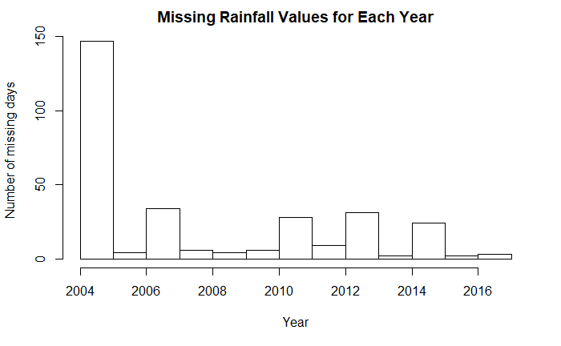
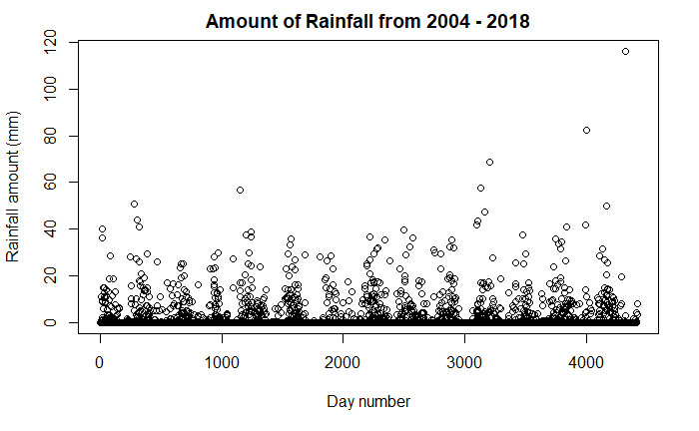
Exploratory Data Analysis

Slide 9
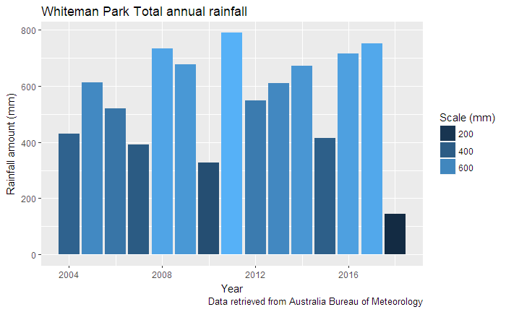
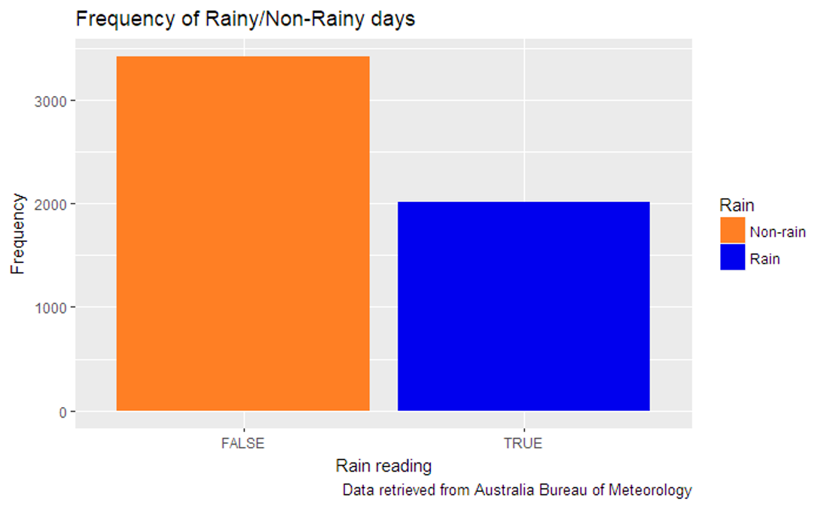

Slide 10
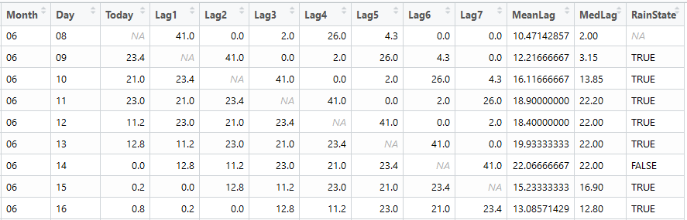
Restructuring the raw data
Did it rain today? (TRUE if it did),
(FALSE if it didn’t)
Average rainfall over the last week
Inspired by Workshop 10 (Thanks, Aloke!)
Broke down data into lagged terms
RainState – TRUE if it rained, FALSE if it didn’t
Mean and Median lag also created as parameters
The date that our data was collected
How much rain fell n days ago
Median rainfall over the last week

Slide 11
What are our limits?
Our raw data isn’t complete
The logistic model worked well with the large dataset, but it only makes a yes/no prediction
Our neural network takes a very long time for the many rows
Our neural network isn’t as reliable; it can converge to different solutions

Slide 12
2004
2005
2006
2007
2008
2009
2010
2011
2012
2013
2014
2015
2016
2017
Training (349)
Training
(3531)
Randomly Selected
Test
(350)
Test (882)
Logistic Model (to predict if it will rain or not)
Our cleaned dataset
Neural Network (to predict how much rain will fall)

Slide 13
Forward Propagation
Inputs
Hidden
Output
Each input is a parameter (Lag1, Lag2)
The network will randomly assign weights to each input. (Gold)
It will try to approach the output it knows
4
-2.4
41.6
98
4076.8
3.2
12.5
Backward Propagation
Inputs
Hidden
Output
We can adjust the weights so that the model will predict correctly.
If we repeat this process for all the training data, we should (hopefully!) converge on optimal weights, and have ourselves a decent generalised model
4
3.08
1.3
5
6.5
9.61
12.5

Slide 14
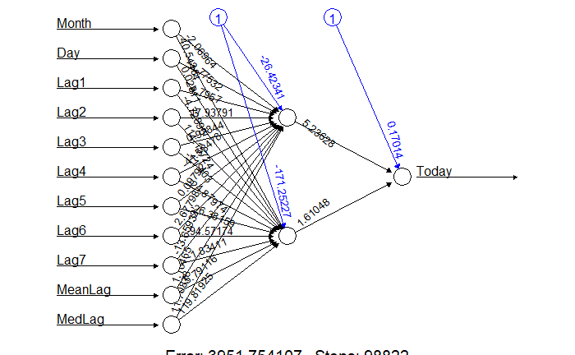
Our Network
Inputs
Hidden
Output

Slide 15
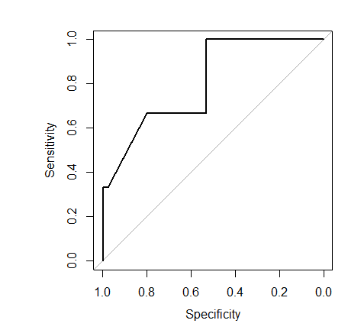
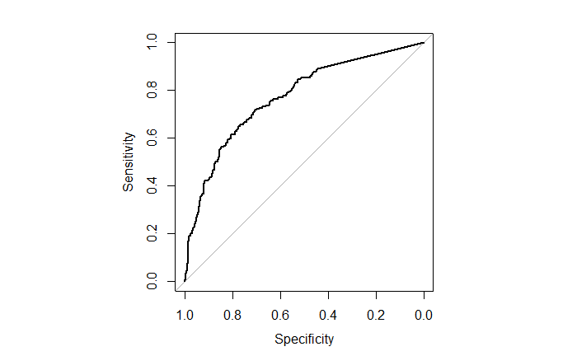
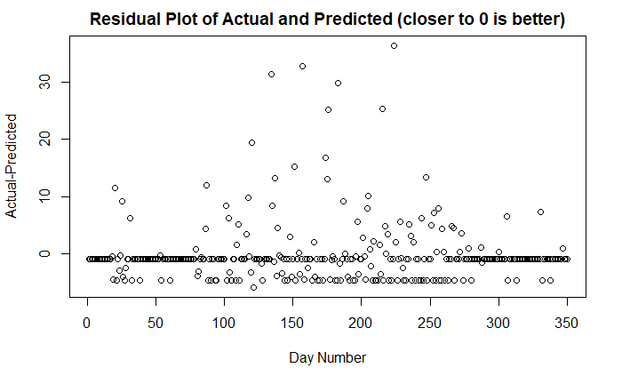

Diagnostic plots
Neural network (Predicting how much rain will fall)
Logistic regression (Predicting if it will rain or not)
Predicts it won’t rain | 82.8%
Predicts it will rain | 76.9%

Slide 16
What can we do next time?
Find a larger, cleaner dataset
Construct a network that is more dense.
Explore other machine learning statistical models
Find a neural network package with GPU support (CUDA)
Make predictions using 80% of the data, rather than 2%
Try predict the next 5-7 days of rainfall, instead of just the next day.

Slide 17
What have we learned?
The bureau of meteorology aren’t that good at recording data
(The biggest thing); Surprisingly, you don’t always need a lot of data to train a neural net.
Using ‘generalised’ parameters (mean/median) gave a better conclusion than without
Anything is possible through the power of interpretive dance

Slide 18
Structure/Documentation & References
Structure based on Smarket Data – Workshop 10
https://lms.curtin.edu.au/bbcswebdav/pid-5806167-dt-content-rid-30797293_1/courses/2018_1_STAT1003_V1_L1_A1_INT_639263/Week%2010/S1_2018_STAT1003_Workshop_10_Solution.html
Accessing the raw weather data from the Bureau of Meteorology
http://www.bom.gov.au/climate/data/stations/

